Slide 1
Building Data Science Capacity in Your Organization
Strata Data Conference, London
May 2019

Slide 2
Building Data Science Capacity in Your Organization:
Hire people with super powers.
Identify and reward self learners.
Use case-studies in your technical training.

Slide 3

There are many paths to data science.
Retail Analytics
SQL & Excel
MSc. Business Analytics
R
Notes:
What was your journey to data science?
Would an algorithm hire you today?

Slide 4

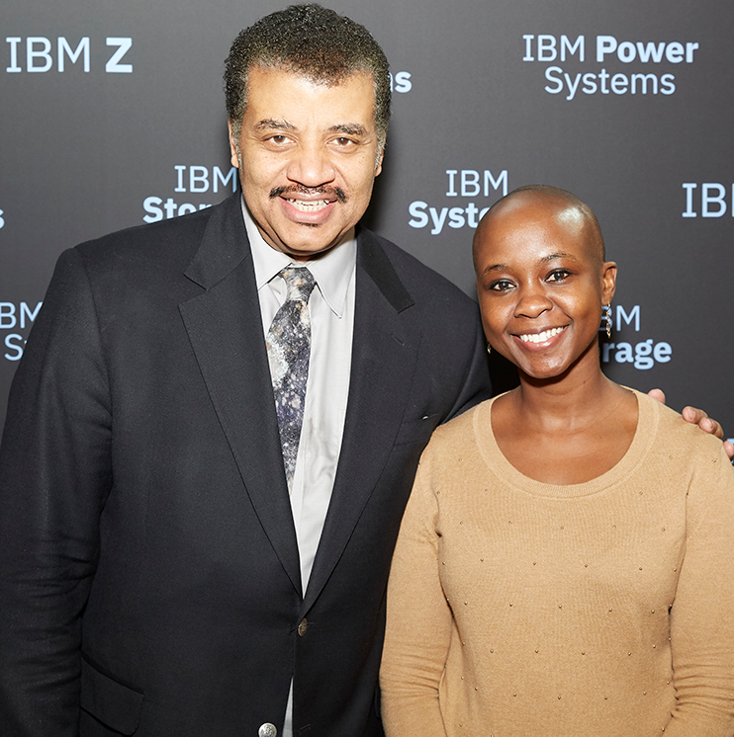
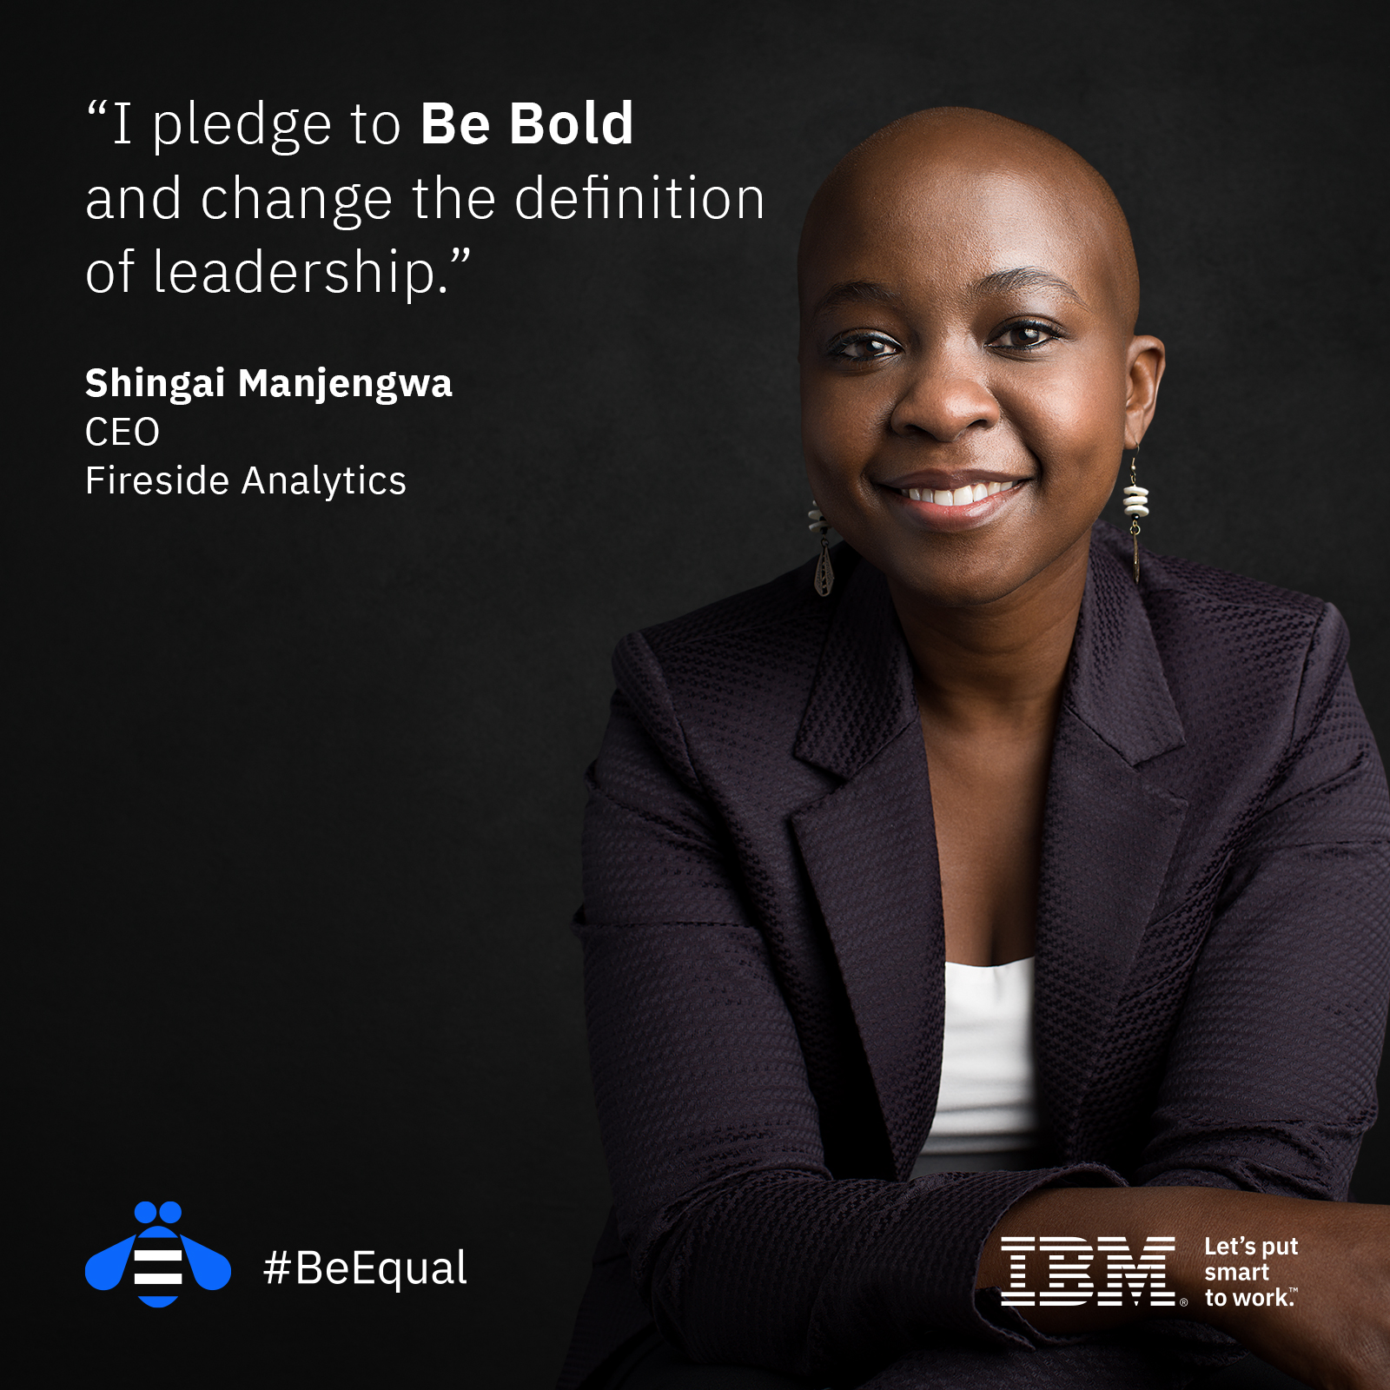
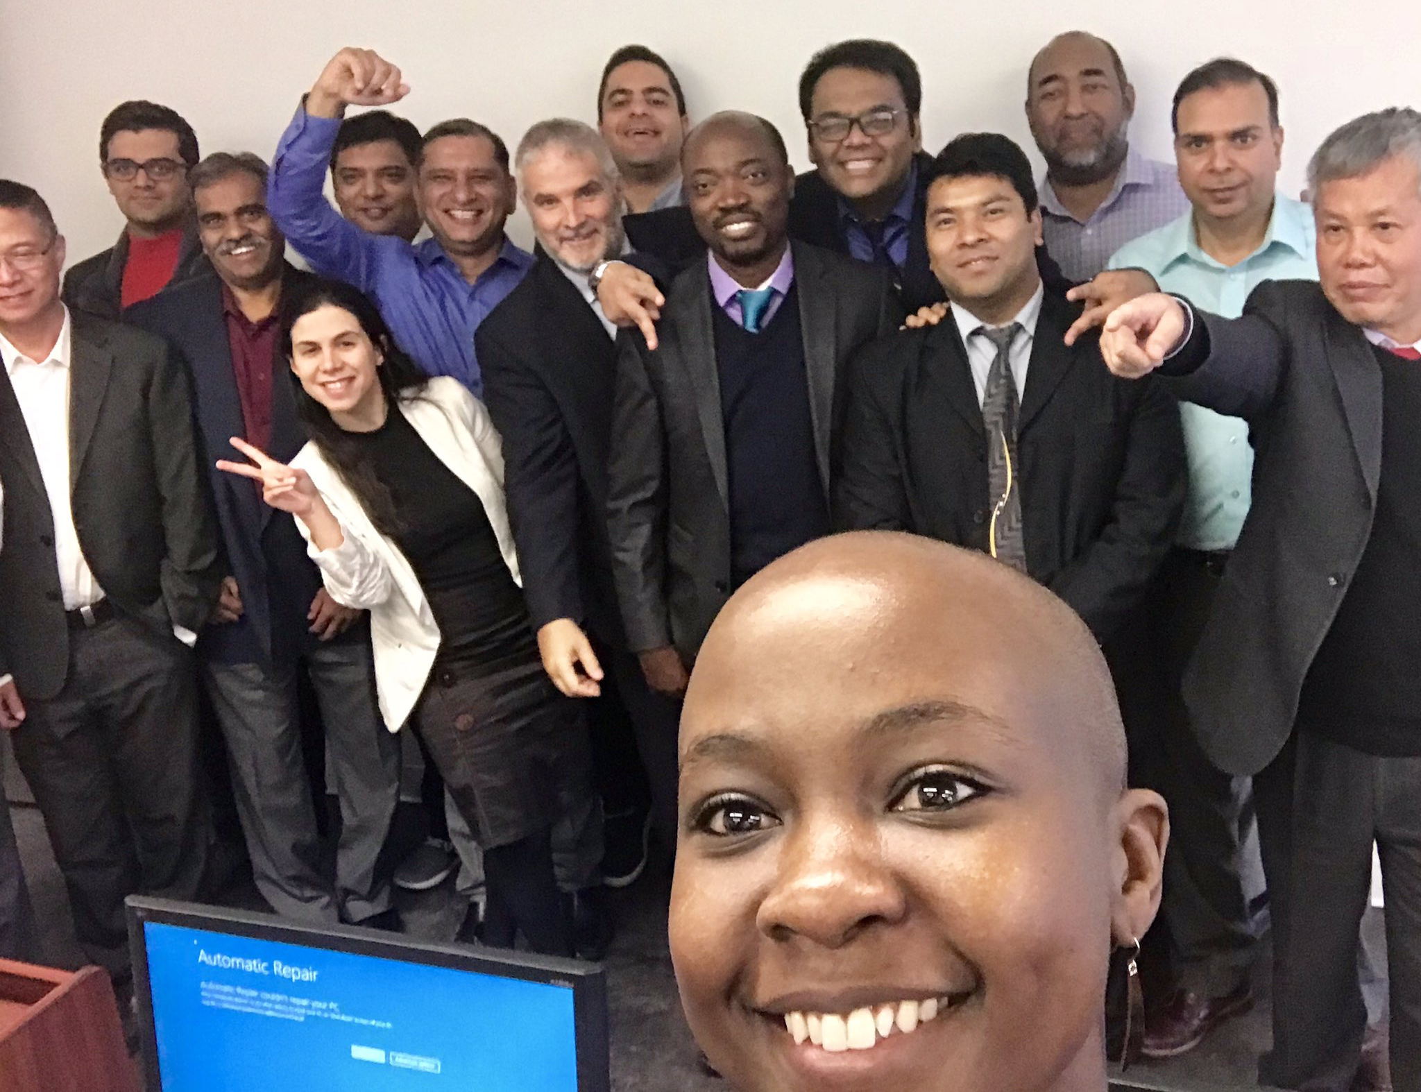
Shingai
@Tjido
Notes:
Data Science for High School

Slide 5

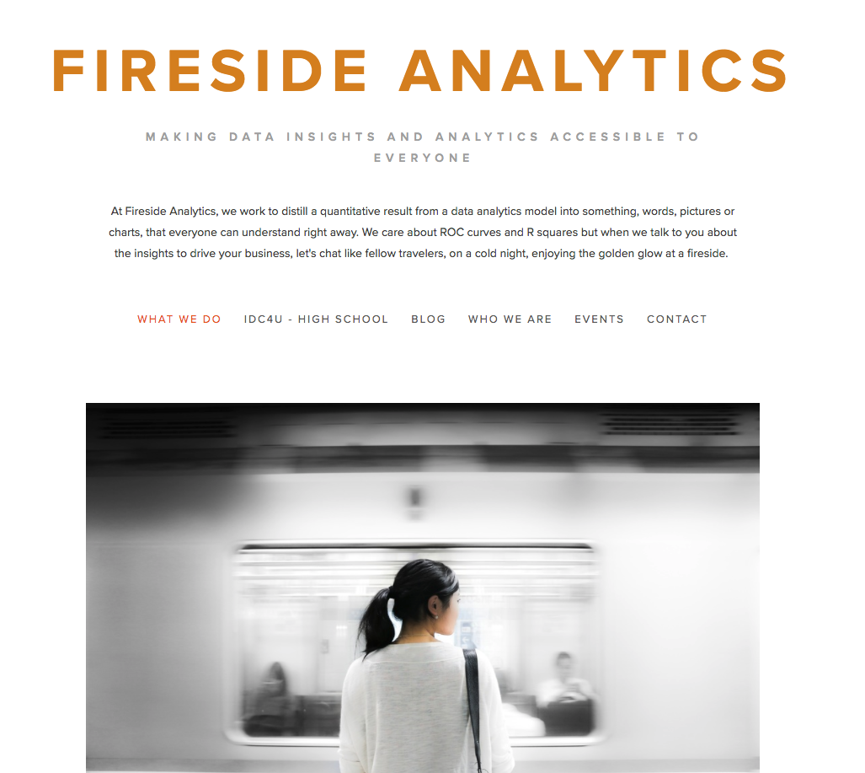

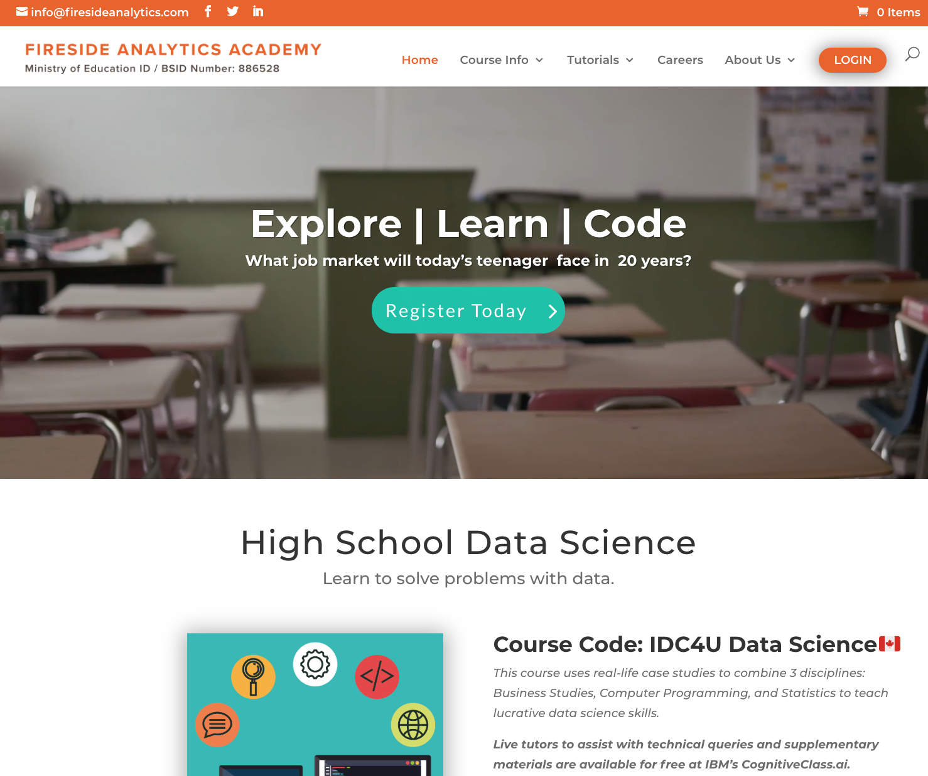
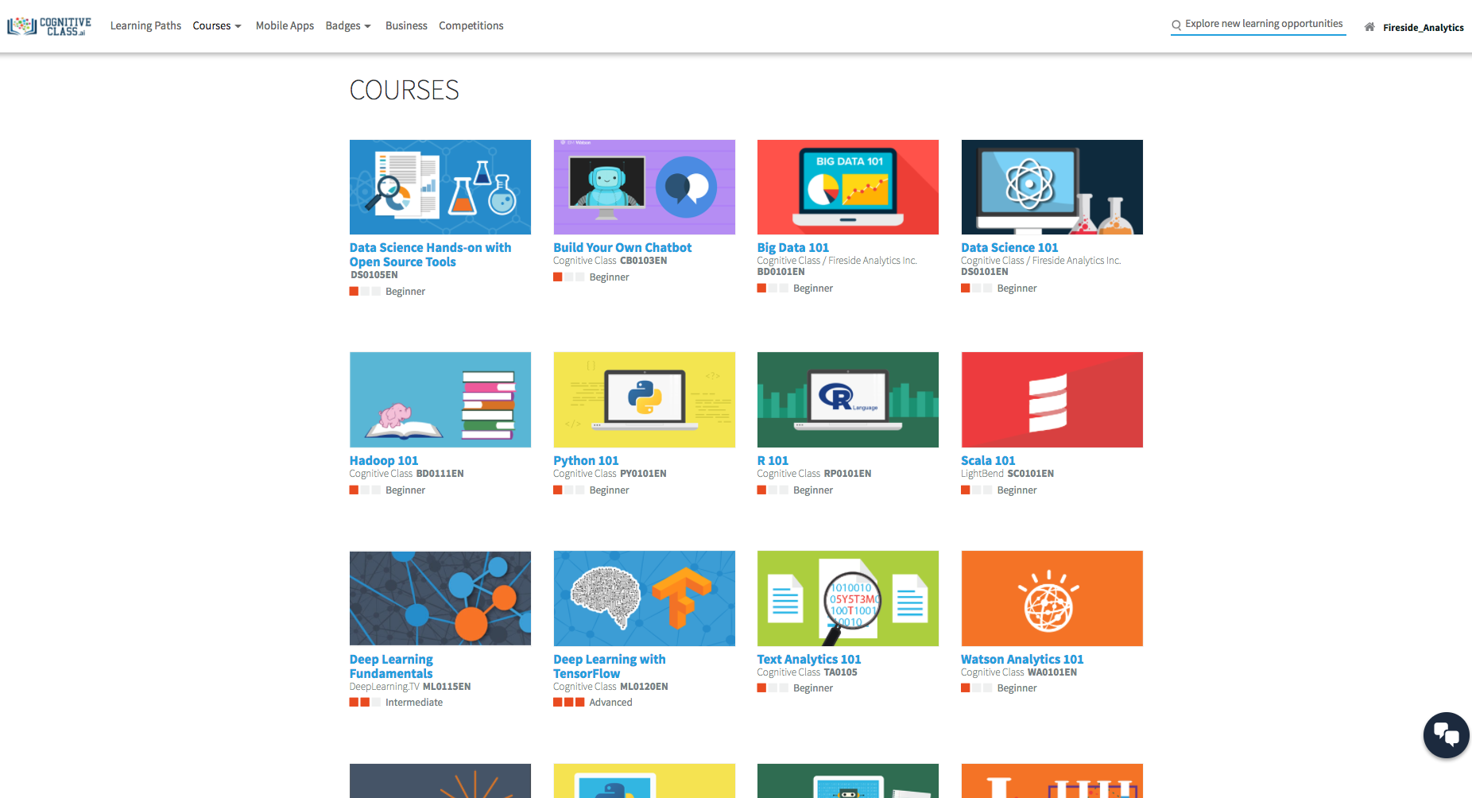
Fireside Analytics 🔥 @fireside_info
Notes:
Insights from teaching data science to
300,000 online learners
Second-career college graduates and,
Grade 12/6th form high school students

Slide 6

Hire people with super powers.
Notes:
Second-career college graduates
Hire people with super powers.
Identify and reward self learners.
Use case-studies in your technical training.

Slide 7
What is Data Science?
Data Science is the process of analyzing, visualizing and monetizing data.
Computer Programming
Engineering
Mathematics
Science
Statistics
Business
At the center of this process is
“the Data Scientist”
Notes:
It uses concepts from mathematics, computer programming and defined industry verticals.

Slide 8
Hiring “the data scientist”
Data Scientist – Welwyn, UK
About the role:
Experience with different programming languages and a good grasp of at least one language - Python, Scala, Java, R (or similar)
Knowledge of open source big-data technology such as Apache Hadoop, Spark, Hive, Pig, MapReduce
Partner with technology teams to productionize your developments and roll out at scale
Source: Glassdoor

Slide 9

Avengers vs. ?
?
Notes:
Speak to other people here, find out how they got here, their journey

Slide 10
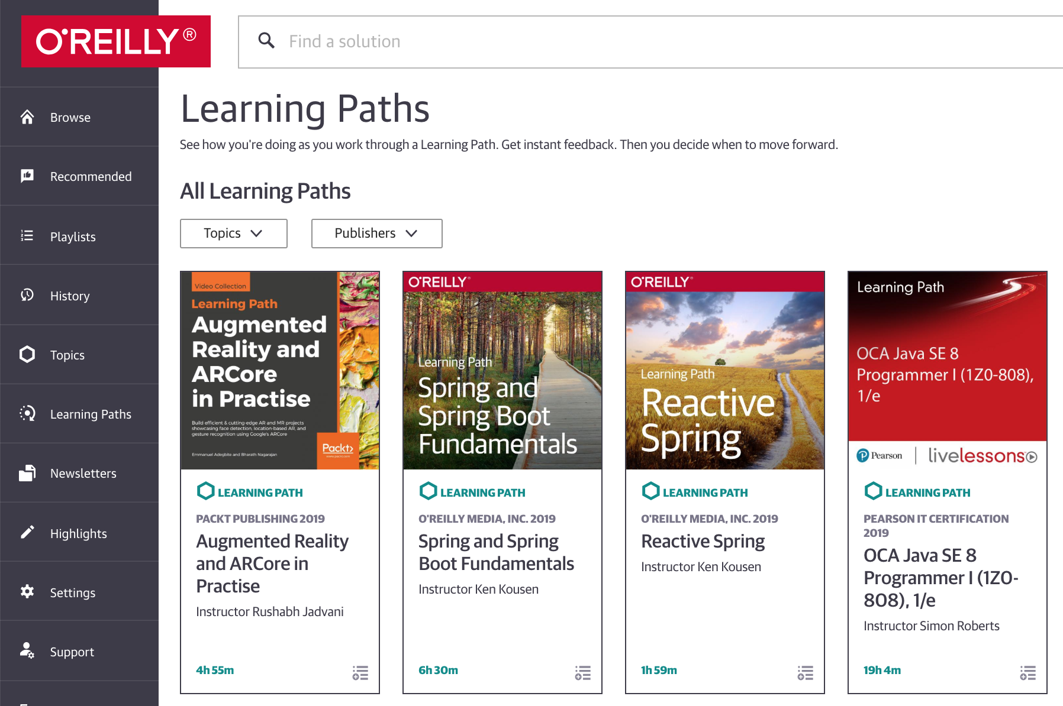
Identify and reward self learners.
MOOCs
CognitiveClass.ai
Coursera
O’Reilly
Conferences
YouTube
Github
Notes:
300K online learners
Techologies keep changing
They are leaving soon
Know who your self learners are

Slide 11
Use case-studies in your technical training.
Notes:
Grade 12/6th form high school students

Slide 12
Building Data Science Capacity in Your Organization:
Hire people with super powers.
Identify and reward self learners.
Use case-studies in your technical training.

Slide 13
Thank you.
Fireside Analytics Inc: info@firesideanalytics.com
  Curricula
  Training and Workshops
  Speaking Engagements
High School Data Science: FiresideAnalytics.Academy
  Completely online, international students welcome
  Registered and inspected by the Ministry of Education in Canada
  Earn an academic credit for the IDC4U course🔥
Free Data Science Courses: CognitiveClass.ai

